Slide 1
ANGULAR FUNDAMENTALS Parte 2
Alejandro Coves Vives

Slide 2
01
02
Contenido
03
04
Attribute Directives
Structural Directives
NgClass, NgStyle y otras maneras de uso
NgIf, NgFor, NgSwitch, Multiple Sibling Structural Directives
Input/Output del Componente
Ciclo de vida del componente
Input, output, changeDetection, , view Proyection
Interface y funciones

Slide 3
01
Attribute Directives
NgClass, NgStyle y otras maneras de uso

Slide 4

Attribute Directives Este tipo de directivas sirven para cambiar el “look and feel”, la capara de apariencia de elementos existentes o componentes donde se aplican.
NgClass
NgStyle
La directive NgCLass nos permite aplicar o remover multiples clases de CSS dinámica y simultaneamente a un elemento en nuestro CSS
La directiva NgStyle es parecida a NgClass pero a un nivel más bajo.
Opera de manera similar a NgClass en que coge un JSON y lo aplica en base a sus claves pero este actúa directamente sobre propiedades del style de css de los elementos..
Las claves y valores corresponden a los que encontramos en el propio CSS

Slide 5

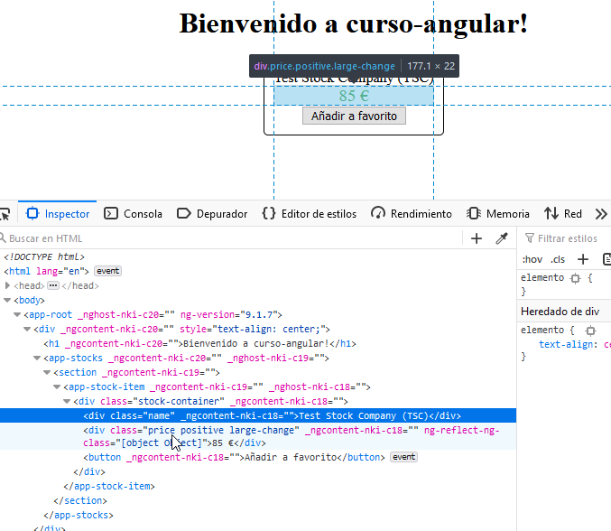
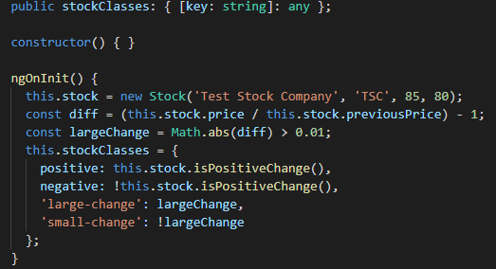
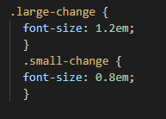
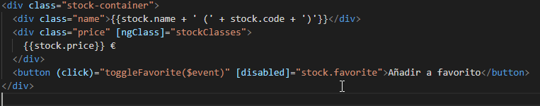
NgClass

Slide 6
NgClass
Permite aplicar o remover clases de CSS de manera dinámica y simultanea a un elemento en nuestro HTML.
Se puede utilizar ya sea desde un objeto de tipo {[nombreClase: string]: boolean } o desde literales. En el objeto evaluará el valor que se le asigne como booleano, con los falsy y trusty característicos de la coerción de JavaScript.
NgClass no sobrescribe elementos existentes en el class del elemento.
Notes:
The NgClass directive allows us to apply or remove multiple CSS classes simultane‐
ously from an element in our HTML. Previously, we applied a single class to our ele‐
ment to highlight whether it was a positive or a negative change as follows:
<div [class]="stock.isPositiveChange() ? 'positive' : 'negative'">
$ {{stock.price}}
</div>
In this example, we simply look at a boolean value, and then decide whether to apply
the class positive or negative based on that. But what if we had to apply multiple
CSS classes? And they were all (or a lot of them) conditional? You would end up hav‐
ing to write code that does string generation based on these multiple conditions, so
that you could have one string that represents all the classes that need to be applied.
This is cruft code that is not worth writing or maintaining. So for these kinds of situa‐
tions, Angular provides the NgClass directive, which can take a JavaScript object as
input. For each key in the object that has a truthy value, Angular will add that key
(the key itself, not the value of the key!) as a class to the element. Similarly, each key
in the object that has a falsy value will be removed as a class from that element
Let’s take an example to see this in action. Say we want to extend our example from
before, where instead of just a positive and a negative class, we want to add another
class that dictates whether it is a large or a small change. We want it to be a small
change (denoted by the CSS class small-change ) if the change percentage is less than
1%; otherwise it would be a large change (denoted by the CSS class large-change ).
Now if you run this application in your browser ( ng serve , in case you have forgot‐
ten), you can see the impact of your changes. The price is now shown in green, as well
as in slightly larger font, since it has applied both the positive and the large-change
classes. You can play around with the values of price and previous price in the com‐
ponent class to see the different combinations reflected.
Another thing to note is that unlike before, where the class binding was overwriting
our initial class from the element, the NgClass directive retains the classes on the
element.
The finished code for the preceding example is available in the chapter3/ng-class
folder in the GitHub repository.
You should consider using the NgClass directive if you have the use case of having to
apply various different CSS classes on an element conditionally. It makes it easy to
reason and understand how and what classes are applied, and it also makes it easy to
unit test the logic of selecting classes separate from the logic of applying classes to the
elements.

Slide 7
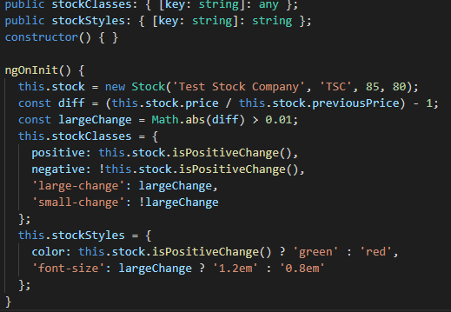
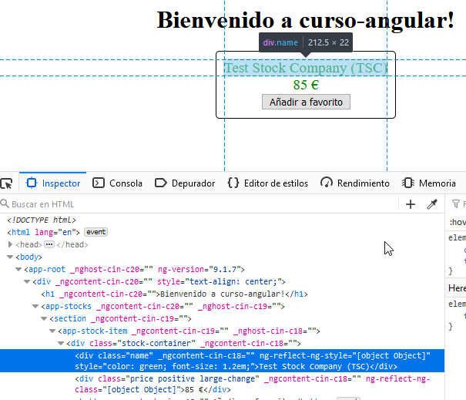
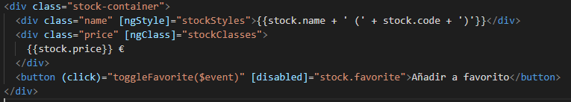
NgStyle

Slide 8
NgStyle
Permite aplicar o remover estilos CSS de manera dinámica y simultanea a un elemento en nuestro HTML.
Se puede utilizar ya sea desde un objeto de tipo {[nombreClase: string]: string } o desde literales. En ambos casos tiene que ser nomenclatura de CSS real para que funcione correctamente .
NgClass no sobrescribe styles existentes en el elemento.
Notes:
The NgStyle directive is the lower-level equivalent of the NgClass directive. It oper‐
ates in a manner similar to the NgClass in that it takes a JSON object and applies it
based on the values of the keys. But the NgStyle directive works at a CSS style/prop‐
erties level. The keys and values it expects are CSS properties and attributes rather
than class names.
Angular will look at the keys and values of the stockStyles object and add those par‐
ticular styles to the HTML element. You can again run the application and try chang‐
ing the values of the price and previous price to see this in action.
The finished code for the preceding example is available in the chapter3/ng-style
folder in the GitHub repository.
It is generally preferable to use the class or NgClass bindings to change the look and
feel of your application, but the NgStyle does give you another tool in your toolkit, in
case you have the use case of changing the CSS style of elements and cannot (for
whatever reasons) use classes to perform the same.

Slide 9
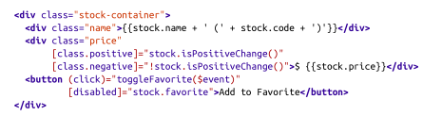
Alternative Class and Style Binding Syntax
Podemos asignar directamente propiedades del class a variables o funciones de manera dinámica.
También se puede hacer con propiedades del style.
Notes:
The NgStyle directive is the lower-level equivalent of the NgClass directive. It oper‐
ates in a manner similar to the NgClass in that it takes a JSON object and applies it
based on the values of the keys. But the NgStyle directive works at a CSS style/prop‐
erties level. The keys and values it expects are CSS properties and attributes rather
than class names.
Angular will look at the keys and values of the stockStyles object and add those par‐
ticular styles to the HTML element. You can again run the application and try chang‐
ing the values of the price and previous price to see this in action.
The finished code for the preceding example is available in the chapter3/ng-style
folder in the GitHub repository.
It is generally preferable to use the class or NgClass bindings to change the look and
feel of your application, but the NgStyle does give you another tool in your toolkit, in
case you have the use case of changing the CSS style of elements and cannot (for
whatever reasons) use classes to perform the same.

Slide 10
02
Structural Directives
NgIf, NgFor, NgSwitch, Multiple Sibling Structural Directives

Slide 11

Structural Directives
NgIf
NgFor
NgSwitch
Para condicionar a que el elemento este físicamente en el HTML o no
Para visualizar múltiples elementos de manera iterada en el HTML
Compendio de varias directivas. Sirve para visualizar elementos en el HTML en función de que una variable cumpla determinado valor

Slide 12
NgIf
Cuando la condición es true renderiza físicamente el elemento en el HTML (lo que hace que dicho elemento se inicialice y siga todos sus ciclos de angular)
Cuando es false el elemento se destruye del DOM.
Hay que tener esto muy en cuenta para estados de elementos y componentes iniciados.
Notes:
We will first take a look at the trusty and often used structural directive NgIf . The
NgIf directive allows you to conditionally hide or show elements in your UI. The syn‐
tax, as mentioned earlier, starts with an asterisk as it is a structural directive that can
conditionally remove or add elements to our rendered HTML.
The NgIf uses one of the simplest microsyntaxes of all the structural directives, as it
simply expects the expression provided to it to evaluate to a truthy value. This is the
JavaScript concept of truthiness (as explained previously), so the boolean true value, a
nonzero number, a nonempty string, and a nonnull object would all be treated as
true. This also makes it convenient to have templates that show up if certain objects
are present and nonnull.
We will build on the examples from the previous chapter, so if you don’t have it, feel
free to grab the final code we were working with from the GitHub repository. The
codebase is in chapter2/stock-market, which is the base for the code in this chapter.
Let’s modify the Add to Favorite button such that instead of getting disabled, we hide
the button if the stock is already favorited. We don’t need to make any changes to the
component or CSS code, but instead just to the src/app/stock/stock-item/stock-
item.component.html file as follows:
<div class="stock-container">
<div class="name">{{stock.name + ' (' + stock.code + ')'}}</div>
<div class="price"
[class]="stock.isPositiveChange() ? 'positive' : 'negative'">
$ {{stock.price}}
</div>
<button (click)="toggleFavorite($event)"
*ngIf="!stock.favorite">Add to Favorite</button>
</div>
On the button , we added the conditionality with *ngIf="!stock.favorite" . This
tells Angular to add the element if the stock is not favorited, and remove it from the
DOM if it is currently a favorite stock. Now when you load the page, you will see the
button by default. Once you click the Add to Favorite button, the boolean will flip
and the stock will now be favorited. Angular will automatically at this point hide the
button from the UI.
If you inspect the HTML of the page, you will see that the element is actually
removed from the rendered DOM
Why Remove Versus Hide Element?
Why does *ngIf remove the element, instead of hiding it via CSS? The reason comes
down to performance and the implications thereof. Angular continues to listen and
watch for events on all elements in the DOM. Removing the element from the DOM
is a good way to ensure that it reduces any impact on performance, especially when
the element being removed is a resource-intensive component (think a graph, or an
autoupdating widget). This does mean that it is slightly less efficient when the condi‐
tion toggles (since it involves a DOM addition/removal), but in the grand context of
things, it is more efficient.
The NgIf directive, along with the NgFor , which we will cover in the following sec‐
tions, are work-horse directives. They do a lot of the heavy lifting and are commonly
used in most applications you will develop.

Slide 13
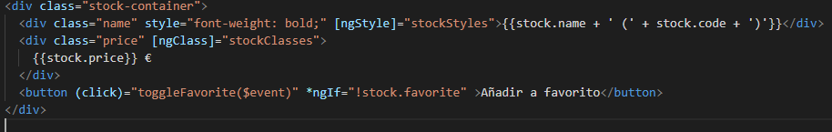
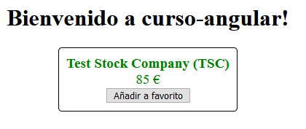
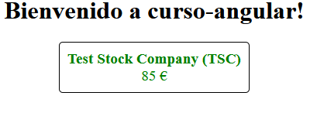
NgIf

Slide 14
NgFor
Se utiliza para mostrar/ocultar elementos de una iteración
Tiene su propia microsintaxis dentro de su directiva.
Cada iteración tiene su propia instancia del elemento/componente.
Elementos internos:
index: Se refiere a la posición del elemento en la iteración.
even: True cuando el elemento es impar
odd: True cuando el elemento es par
first: True cuando es el primer elemento del array
last: True cuando es el último elemento del array
Notes:
While the NgIf directive is used for conditionally showing/hiding elements, the
NgFor directive is used for creating multiple elements, usually one for each instance of
some or the other object in an array. It is a common practice to have a template, and
then create an instance of that template for each instance of our object.
NgFor or NgForOf
Technically, the *ngFor directive uses the class called NgForOf under
the hood. Thus, you might see people use NgFor and NgForOf inter‐
changeably when referring to the *ngFor directive in Angular
Generally, we want to keep a stock-item for one particular stock only, but we will
circumvent that for this particular example. We changed stock to be stocks , an array
of stock objects. We then created some dummy stocks in our initialization. Finally, we
changed the toggleFavorite to take in an index as a parameter, instead of working
with the current stock.
We updated our parent container with the NgFor directive. Let’s explore how we have
used it in a bit more detail:
*ngFor="let stock of stocks; index as i"
The first part of the microsyntax is basically our for loop. We create a template
instance variable named stock , which will be available within the scope of the ele‐
ment created. This can be equated to a standard for-each loop, with the variable
stock referring to each individual item in the array. The second part after the semico‐
lon is creating another template instance variable i , which holds the current index
value. We will talk about the other properties in just a bit.
With this statement, Angular will repeat the stock-container div element once for
each item in the stocks array, thus creating three elements in our final rendered
HTML. You should see something like Figure 3-1 on your screen.
Angular encapsulates the stock and i variables such that each instance of the tem‐
plate has its own copy of them. Thus, when we refer to stock.name inside the ele‐
ment, Angular correctly picks up the relevant stock and displays its name. When we
click the Add to Favorite button, the correct index is passed and only that particular
button is disabled.
Similar to index, there are other local values that are available within the context of an
NgFor directive that you can assign to a local variable name (like we did with i ) and
bind them to different values:
index
This refers to the current element index
even
This is true when the item has an even index
odd
This is true when the item has an odd index
first
This is true when the item is the first item in the array
last
This is true when the item is the last item in the array
You can then use these variables to bind to CSS classes, or display them in the UI, or
run any other calculations you might want to. For instance, you might want to add
the CSS class even-item to each even index item, which you can accomplish with a
binding like:
[css.even-item]="isEven"
where even is assigned to the isEven variable in the NgFor microsyntax like:
*ngFor="let stock of stocks; even as isEven; index as i"
The last major capability that the NgFor directive provides is a hook into how Angular
recognizes elements and avoids re-creating element instances unnecessarily. By
default, Angular uses object identity to track additions, removals, and modifications
to an array. That is, as long as the object reference does not change, Angular will not
create new elements for it, and reuse the old element reference. This is mostly for per‐
formance reasons, as element creation/removal are two of the more costly operations
in the browser.
There are cases when the element reference might change, but you still want to con‐
tinue using the same element. For example, when you fetch new data from the server,
you don’t want to blow away your list and re-create it unless the data has fundamen‐
tally changed. This is where the trackBy capability of the NgFor directive comes into
play.
The trackBy option takes a function that has two arguments: an index and the item.
If the trackBy function is provided to the NgFor directive, then it will use the return
value of the function to decide how to identify individual elements. For example, in
our particular case, we might want to use the stock’s code as an identifier, instead of
the object reference
The last function ( trackStockByCode ) is the one we just added. We are taking both
the index and the stock, and returning the stock.code . Angular will use this value to
identify each element.

Slide 15
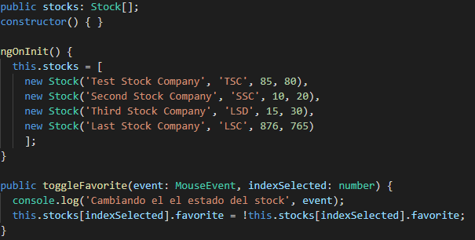
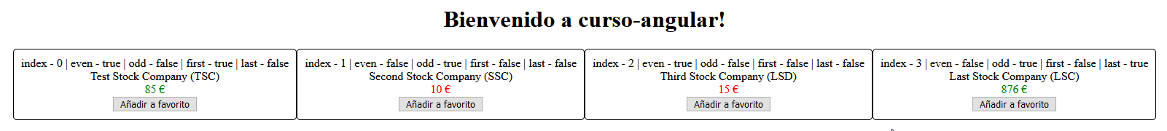
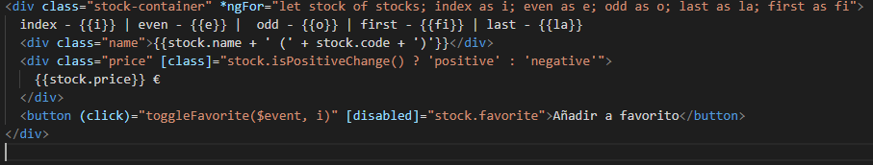
NgFor

Slide 16
NgFor: trackBy
Sirve para decirle a Angular la manera de identificar al elemento en su ecosistema. Si no se reescribe es el propio objeto del elemento en si.
Reescribirlo aligera carga de procesamiento de la página

Slide 17
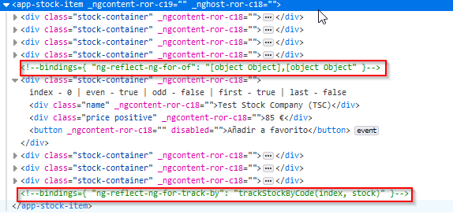
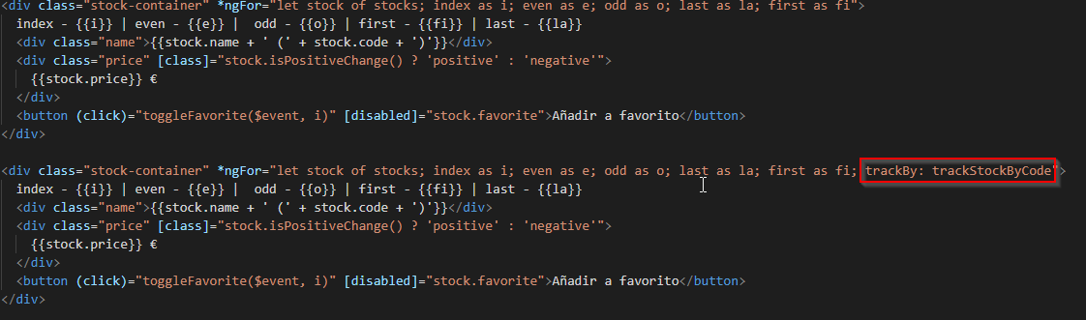
NgFor: trackBy

Slide 18
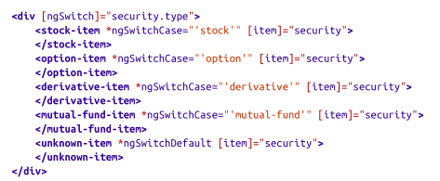
NgSwitch
Es una combinación de varias directivas
Por si misma más que structural directive es un atribute directive.
[ngSwitch] -> Para la variable a controlar
*ngSwitchCase -> Para el case concreto
*ngSwitchDefault -> Para el caso por defecto si no se cumplen los otros condicionantes
Notes:
The last built-in directive is actually a set of multiple directives. NgSwitch by itself is
not a structural directive, but rather an attribute directive. You would use it with nor‐
mal data-binding syntax with the square-bracket notation. It is the NgSwitchCase and
the NgSwitchDefault directives that are, in fact, structural directives, as they would
add or remove elements depending on the case.
Let’s take a hypothetical example to see how this might look in action. Let’s assume
that instead of just stocks, we were dealing with all kinds of securities, like stocks,
options, derivatives, and mutual funds. And we had built components to render each
one of these. Now, given a security we want to render the right kind of component
based on its type. This would be a great example of using an NgSwitch , which might
look something like follows:
<div [ngSwitch]="security.type">
<stock-item *ngSwitchCase="'stock'" [item]="security">
</stock-item>
<option-item *ngSwitchCase="'option'" [item]="security">
</option-item>
<derivative-item *ngSwitchCase="'derivative'" [item]="security">
</derivative-item>
<mutual-fund-item *ngSwitchCase="'mutual-fund'" [item]="security">
</mutual-fund-item>
<unknown-item *ngSwitchDefault [item]="security">
</unknown-item>
</div>
A few interesting things of note in the example:
• We use normal data binding using square brackets with the ngSwitch directive,
as we want it to understand and interpret the value underneath the expression. It
is not a structural directive, as we mentioned previously.
• Each *ngSwitchCase is again taking an expression, and in this case, we are pass‐
ing string constants like 'stock' , 'option' , and so on. If the value of
security.type matches any one of these string constants, then that particular
element will get rendered, and all other sibling elements will be removed.
• If none of the sibling *ngSwitchCase statements matches, then the *ngSwitch
Default will get triggered and in the example, the unknown-item component will
get rendered.
The NgSwitch family of directives is great when you have multiple elements/
templates, of which one has to be rendered based on conditions.

Slide 19
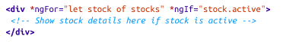
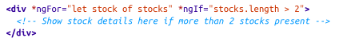
Uso de varias structural directives a la vez
No es posible combinar en un mismo elemento varias de estas directivas
Ejemplo el siguiente código, en la primera analiza el elemento que recorre y en la segunda el elemento exterior. Angular simplifica este problema no dejando en ninguno de los dos casos.
Notes:
The last built-in directive is actually a set of multiple directives. NgSwitch by itself is
not a structural directive, but rather an attribute directive. You would use it with nor‐
mal data-binding syntax with the square-bracket notation. It is the NgSwitchCase and
the NgSwitchDefault directives that are, in fact, structural directives, as they would
add or remove elements depending on the case.
Let’s take a hypothetical example to see how this might look in action. Let’s assume
that instead of just stocks, we were dealing with all kinds of securities, like stocks,
options, derivatives, and mutual funds. And we had built components to render each
one of these. Now, given a security we want to render the right kind of component
based on its type. This would be a great example of using an NgSwitch , which might
look something like follows:
<div [ngSwitch]="security.type">
<stock-item *ngSwitchCase="'stock'" [item]="security">
</stock-item>
<option-item *ngSwitchCase="'option'" [item]="security">
</option-item>
<derivative-item *ngSwitchCase="'derivative'" [item]="security">
</derivative-item>
<mutual-fund-item *ngSwitchCase="'mutual-fund'" [item]="security">
</mutual-fund-item>
<unknown-item *ngSwitchDefault [item]="security">
</unknown-item>
</div>
A few interesting things of note in the example:
• We use normal data binding using square brackets with the ngSwitch directive,
as we want it to understand and interpret the value underneath the expression. It
is not a structural directive, as we mentioned previously.
• Each *ngSwitchCase is again taking an expression, and in this case, we are pass‐
ing string constants like 'stock' , 'option' , and so on. If the value of
security.type matches any one of these string constants, then that particular
element will get rendered, and all other sibling elements will be removed.
• If none of the sibling *ngSwitchCase statements matches, then the *ngSwitch
Default will get triggered and in the example, the unknown-item component will
get rendered.
The NgSwitch family of directives is great when you have multiple elements/
templates, of which one has to be rendered based on conditions.

Slide 20
EJERCICIO!
A partir del ejercicio de la parte 01.
Usar ngClass o ngStyle para resaltar el elemento en lugar de la clase.
En lugar de deshabilitar el botón cuando la cantidad sea 0 hacerlo desaparecer del DOM con ngIf.
Usar ngFor para cada vez que se sume o se reste un elemento se visualice (desde 0 hasta 20)

Slide 21
03
Input/Output
Input, output, changeDetection, view Proyection

Slide 22
Input
Input/ Output
Output
Decorador que sirve para el paso de variables entre componentes
Decorador que sirve para registrar y escuchar eventos de un componente

Slide 23
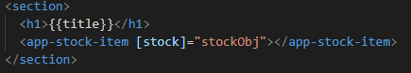
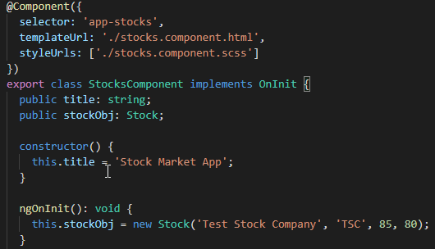
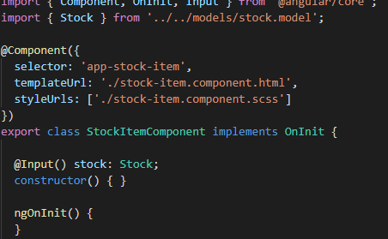
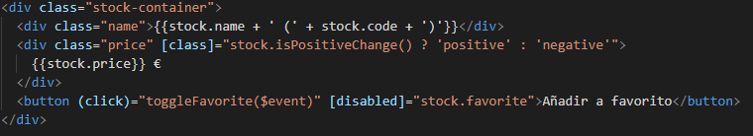
Input
Notes:
When we add an Input decorator on a member variable, it automatically allows you
to pass in values to the component for that particular input via Angular’s data binding
syntax.
Let’s see how we can extend our stock-item component from the previous chapter to
allow us to pass in the stock object, rather than hardcoding it within the component
itself. The finished example is available in the GitHub repository in the chapter4/
component-input folder. If you want to code along and don’t have the previous code,
you can use the chapter3/ng-if codebase as the starter to code along from.
We have removed all instantiation logic from the app-stock-item component, and
marked the stock variable as an input. This means that the initialization logic has
been moved out, and the component is only responsible for receiving the value of the
stock from the parent component and just rendering the data.
We use Angular’s data binding to pass in the stock from the AppComponent to the
StockItemComponent . The name of the attribute ( stock ) has to match the name of
the variable in the component that has been marked as input. The attribute name is
case sensitive, so make sure it matches exactly with the input variable name. The
value that we pass to it is the reference of the object in the AppComponent class, which
is stockObj
HTML and Case-Sensitive Attributes?
You might wonder how this is even possible. Angular has its own
HTML parser under the covers that parses the templates for
Angular-specific syntax, and does not rely on the DOM API for
some of these. This is why Angular attributes are and can be case-
sensitive.
These inputs are data bound, so if you end up changing the value of the object in
AppComponent , it will automatically be reflected in the child StockItemComponent

Slide 24
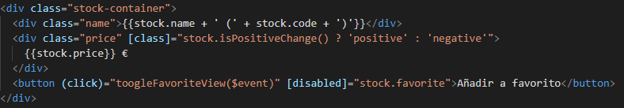
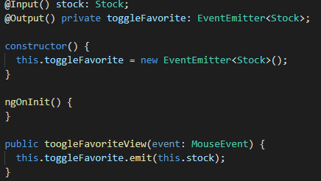
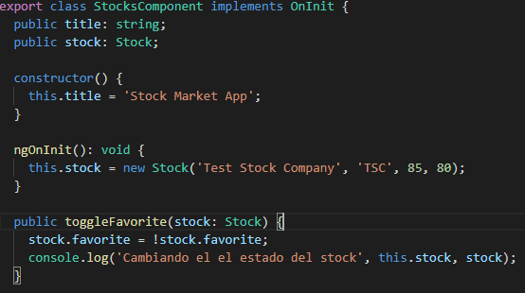
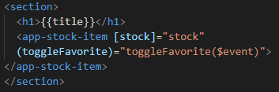
Output
Notes:
Just like we can pass data into a component, we can also register and listen for events
from a component. We use data binding to pass data in, and we use event binding
syntax to register for events. We use the Output decorator to accomplish this.
We register an EventEmitter as an output from any component. We can then trigger
the event using the EventEmitter object, which will allow any component bound to
the event to get the notification and act accordingly.
We can use the code from the previous example where we registered an Input deco‐
rator and continue on from there. Let’s now extend the StockComponent to trigger an
event when it is favorited, and move the data manipulation out from the component
to its parent. This makes sense as well because the parent component is responsible
for the data and should be the single source of truth. Thus, we will let the parent App
Component register for the toggleFavorite event and change the state of the stock
when the event is triggered.
The finished code for this is in the chapter4/component-output folder.
Take a look at the StockItemComponent code in src/app/stock/stock-item/stock-
item.component.ts:
import { Component, OnInit, Input, Output, EventEmitter } from '@angular/core';
import { Stock } from '../../model/stock';
64 | Chapter 4: Understanding and Using Angular Components
@Component({
selector: 'app-stock-item',
templateUrl: './stock-item.component.html',
styleUrls: ['./stock-item.component.css']
})
export class StockItemComponent {
@Input() public stock: Stock;
@Output() private toggleFavorite: EventEmitter<Stock>;
constructor() {
this.toggleFavorite = new EventEmitter<Stock>();
}
onToggleFavorite(event) {
this.toggleFavorite.emit(this.stock);
}
}
A few important things to note:
• We imported the Output decorator as well as the EventEmitter from the Angular
library.
• We created a new class member called toggleFavorite of type EventEmitter ,
and renamed our method to onToggleFavorite . The EventEmitter can be typed
for additional type safety.
• We need to ensure that the EventEmitter instance is initialized, as it is not auto-
initialized for us. Either do it inline or do it in the constructor as we did earlier.
• The onToggleFavorite now just calls a method on the EventEmitter to emit the
entire stock object. This means that all listeners of the toggleFavorite event will
get the current stock object as a parameter.
We will also change stock-item.component.html to call the onToggleFavorite method
instead of toggleFavorite . The HTML markup remains pretty much the same
otherwise:
<div class="stock-container">
<div class="name">{{stock.name + ' (' + stock.code + ')'}}</div>
<div class="price"
[class]="stock.isPositiveChange() ? 'positive' : 'negative'">
$ {{stock.price}}
</div>
<button (click)="onToggleFavorite($event)"
*ngIf="!stock.favorite">Add to Favorite</button>
</div>
Input and Output | 65
Next, we add a method to the AppComponent that should be triggered whenever the
onToggleFavorite method is triggered, which we will add event binding on:
import { Component, OnInit } from '@angular/core';
import { Stock } from 'app/model/stock';
@Component({
selector: 'app-root',
templateUrl: './app.component.html',
styleUrls: ['./app.component.css']
})
export class AppComponent implements OnInit {
title = 'app works!';
public stock: Stock;
ngOnInit(): void {
this.stock = new Stock('Test Stock Company', 'TSC', 85, 80);
}
onToggleFavorite(stock: Stock) {
console.log('Favorite for stock ', stock, ' was triggered');
this.stock.favorite = !this.stock.favorite;
}
}
The only thing new is the onToggleFavorite method we have added, which takes a
stock as an argument. In this particular case, we don’t use the stock passed to it other
than for logging, but you could base any decision/work on that. Note also that the
name of the function is not relevant, and you could name it whatever you want.
Finally, let’s tie it all together by subscribing to the new output from our
StockComponent in the app-component.html file:
<h1>
{{title}}
</h1>
<app-stock-item [stock]="stock"
(toggleFavorite)="onToggleFavorite($event)">
</app-stock-item>
We just added an event binding using Angular’s event-binding syntax to the output
declared in the stock-item component. Notice again that it is case sensitive and it
has to exactly match what member variable we decorated with the Output decorator.
Also, to get access to the value emitted by the component, we use the keyword $event
as a parameter to the function. Without it, the function would still get triggered, but
you would not get any arguments with it.
66 | Chapter 4: Understanding and Using Angular Components
With this, if you run the application (remember, ng serve ), you should see the fully
functional app, and when you click the Add to Favorite button, it should trigger the
method in the AppComponent

Slide 25
Detección de cambios
Angular por defecto pone la detección de cambios como : ChangeDetectionStrategy.Default
Para aplicaciones grandes es conveniente optimizar la detección de cambios con la estrategia ChangeDetectionStrategy.OnPush
Esto tiene algunos inconvenientes:
Si un componente tiene esta estrategia y se pasan datos por @Input y su padre cambia propiedades del objeto no se enterará
Notes:
We mentioned changeDetection as an attribute on the Component decorator. Now
that we have seen how Input and Output decorators work, let’s deep dive a little bit
into how Angular performs its change detection at a component level.
By default, Angular applies the ChangeDetectionStrategy.Default mechanism to
the changeDetection attribute. This means that every time Angular notices an event
(say, a server response or a user interaction), it will go through each component in
the component tree, and check each of the bindings individually to see if any of the
values have changed and need to be updated in the view.
For a very large application, you will have lots of bindings on a given page. When a
user takes any action, you as a developer might know for sure that most of the page
will not change. In such cases, you can actually give a hint to the Angular change
detector to check or not check certain components as you see fit. For any given com‐
ponent, we can accomplish this by changing the ChangeDetectionStrategy from the
default to ChangeDetectionStrategy.OnPush . What this tells Angular is that the
bindings for this particular component will need to be checked only based on the
Input to this component.
Let’s consider a few examples to see how this might play out. Say we have a compo‐
nent tree A → B → C. That is, we have a root component A, which uses a component
B in its template, which in turn uses a component C. And let’s say component B
passes in a composite object compositeObj to component C as input. Maybe some‐
thing like:
<c [inputToC]="compositeObj"></c>
That is, inputToC is the input variable marked with the Input decorator in compo‐
nent C, and is passed the object compositeObj from component B. Now say we
marked component C’s changeDetection attribute as ChangeDetectionStrategy
.OnPush . Here are the implications of that change:
• If component C has bindings to any attributes of compositeObj , they will work as
usual (no change from default behavior).
• If component C makes any changes to any of the attributes of compositeObj , they
will also be updated immediately (no change from default behavior).
• If the parent component B creates a new compositeObj or changes the reference
of compositeObj (think new operator, or assign from a server response), then
Input and Output | 67
component C would recognize the change and update its bindings for the new
value (no change from default behavior, but internal behavior changes on how
Angular recognizes the change).
• If the parent component B changes any attribute on the compositeObj directly
(as a response to a user action outside component B), then these changes would
not be updated in component C (major change from the default behavior).
• If the parent component B changes any attribute on response to an event emitter
from component C, and then changes any attribute on the compositeObj
(without changing the reference), this would still work and the bindings would
get updated. This is because the change originates from component C (no change
from default behavior).
Angular provides ways for us to signal when to check the bindings from within the
component as well, to have absolute control on Angular’s data binding. We will cover
these in “Change Detection” on page 67. For now, it is good to understand the differ‐
ence between the two change detection strategies that Angular provides.
Let’s now modify the example code to see this in action. First, modify the stock-
item.component.ts file to change the ChangeDetectionStrategy in the child compo‐
nent:
import { Component, OnInit, Input, Output } from '@angular/core';
import { EventEmitter, ChangeDetectionStrategy } from '@angular/core';
import { Stock } from '../../model/stock';
@Component({
selector: 'app-stock-item',
templateUrl: './stock-item.component.html',
styleUrls: ['./stock-item.component.css'],
changeDetection: ChangeDetectionStrategy.OnPush
})
export class StockItemComponent {
@Input() public stock: Stock;
@Output() private toggleFavorite: EventEmitter<Stock>;
constructor() {
this.toggleFavorite = new EventEmitter<Stock>();
}
onToggleFavorite(event) {
this.toggleFavorite.emit(this.stock);
}
changeStockPrice() {
this.stock.price += 5;
68 | Chapter 4: Understanding and Using Angular Components
}
}
In addition to changing the ChangeDetectionStrategy , we also added another func‐
tion to changeStockPrice() . We will use these functions to demonstrate the behavior
of the change detection in the context of our application.
Next, let’s quickly modify stock-item.component.html to allow us to trigger the new
function. We will simply add a new button to trigger and change the stock price when
the button is clicked:
<div class="stock-container">
<div class="name">{{stock.name + ' (' + stock.code + ')'}}</div>
<div class="price"
[class]="stock.isPositiveChange() ? 'positive' : 'negative'">
$ {{stock.price}}
</div>
<button (click)="onToggleFavorite($event)"
*ngIf="!stock.favorite">Add to Favorite</button>
<button (click)="changeStockPrice()">Change Price</button>
</div>
There is no change to the HTML of the template other than adding a new button to
change the stock price. Similarly, let’s quickly change the main app.component.html
file to add another button to trigger the change of the price from the parent compo‐
nent (similar to component B in the earlier hypothetical example):
<h1>
{{title}}
</h1>
<app-stock-item [stock]="stock"
(toggleFavorite)="onToggleFavorite($event)">
</app-stock-item>
<button (click)="changeStockObject()">Change Stock</button>
<button (click)="changeStockPrice()">Change Price</button>
We have added two new buttons to this template: one that will change the reference
of the stock object directly, and another that will modify the existing reference of the
stock object to change the price from the parent AppComponent . Now finally, we can
see how all of this is hooked up in the app.component.ts file:
import { Component, OnInit } from '@angular/core';
import { Stock } from 'app/model/stock';
@Component({
selector: 'app-root',
templateUrl: './app.component.html',
styleUrls: ['./app.component.css']
})
export class AppComponent implements OnInit {
title = 'app works!';
Input and Output | 69
public stock: Stock;
private counter: number = 1;
ngOnInit(): void {
this.stock = new Stock('Test Stock Company - ' + this.counter++,
'TSC', 85, 80);
}
onToggleFavorite(stock: Stock) {
// This will update the value in the stock item component
// Because it is triggered as a result of an event
// binding from the stock item component
this.stock.favorite = !this.stock.favorite;
}
changeStockObject() {
// This will update the value in the stock item component
// Because we are creating a new reference for the stock input
this.stock = new Stock('Test Stock Company - ' + this.counter++,
'TSC', 85, 80);
}
changeStockPrice() {
// This will not update the value in the stock item component
// because it is changing the same reference and angular will
// not check for it in the OnPush change detection strategy.
this.stock.price += 10;
}
}
The app.component.ts file has seen the most changes. The preceding code is also well
annotated with comments to explain the expected behavior when each of these func‐
tions are triggered. We have added two new methods: changeStockObject() , which
creates a new instance of the stock object in the AppComponent , and changeStock
Price() , which modifies the prices of the stock object in the AppComponent . We have
also added a counter just to keep track of how many times we create a new stock
object, but that is not strictly necessary.
Now when you run this application, you should expect to see the following behavior:
• Clicking Add to Favorite within the StockItemComponent still works as expected.
• Clicking Change Price within the StockItemComponent will increase the price of
the stock by $5 each time.
• Clicking Change Stock outside the StockItemComponent will change the name of
the stock with each click. (This is why we added the counter!)
• Clicking Change Price outside the StockItemComponent will have no impact
(even though the actual value of the stock will jump if you click Change Price
70 | Chapter 4: Understanding and Using Angular Components
inside after this). This shows that the model is getting updated, but Angular is
not updating the view.
You should also change back the ChangeDetectionStrategy to default to see the dif‐
ference in action.

Slide 26
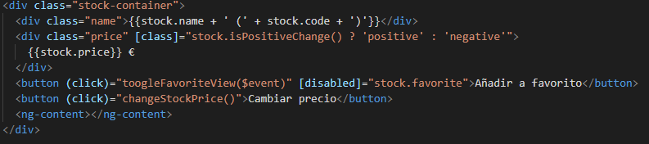
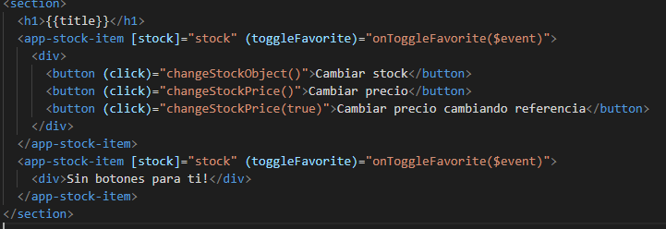
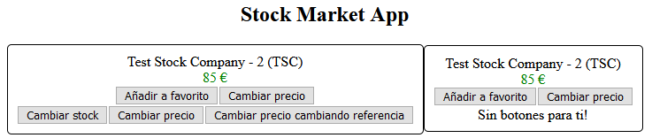
View Proyection
Notes:
The last thing we will cover in this chapter is the concept of view projection. Projec‐
tion is an important idea in Angular as it gives us more flexibility when we develop
our components and again gives us another tool to make them truly reusable under
different contexts.
Projection is useful when we want to build components but set some parts of the UI
of the component to not be an innate part of it. For example, say we were building a
component for a carousel. A carousel has a few simple capabilities: it is able to display
an item, and allow us to navigate to the next/previous element. Your carousel compo‐
nent might also have other features like lazy loading, etc. But one thing that is not the
purview of the carousel component is the content it displays. A user of the compo‐
nent might want to display an image, a page of a book, or any other random thing.
Thus, in these cases, the view would be controlled by the user of the component, and
the functionality would be provided by the component itself. This is but one use case
where we might want to use projection in our components.
Let’s see how we might use content projection in our Angular application. We will use
the base from the input example to build from, so in case you are not coding along,
you can take the example from chapter4/component-input to build from there.
The final finished example is available in chapter4/component-projection.
First, we will modify our StockItemComponent to allow for content projection. There
is no code change in our component class; we only need to modify the src/app/stock/
stock-item/stock-item.component.html file as follows:
<div class="stock-container">
<div class="name">{{stock.name + ' (' + stock.code + ')'}}</div>
<div class="price"
[class]="stock.isPositiveChange() ? 'positive' : 'negative'">
$ {{stock.price}}
</div>
<ng-content></ng-content>
</div>
The new ng-content element for projection
We have simply removed the buttons we previously had, and are going to let the user
of the component decide what buttons are to be shown. To allow for this, we have
View Projection | 77
replaced the buttons with an ng-content element. There is no other change required
in the component.
Next, we will make a change to the AppComponent , simply to add a method for testing
purposes. Modify the src/app/app.component.ts file as follows:
/** Imports and decorators skipped for brevity **/
export class AppComponent implements OnInit {
/** Constructor and OnInit skipped for brevity **/
testMethod() {
console.log('Test method in AppComponent triggered');
}
}
We have simply added a method that will log to the console when it is triggered. With
this in place, now let’s see how we can use our updated StockItemComponent and use
the power of projection. Modify the app.component.html file as follows:
<h1>
{{title}}
</h1>
<app-stock-item [stock]="stockObj">
<button (click)="testMethod()">With Button 1</button>
</app-stock-item>
<app-stock-item [stock]="stockObj">
No buttons for you!!
</app-stock-item>
We have added two instances of the app-stock-item component in our HTML. And
both of these now have some content inside them, as opposed to previously where
these elements had no content. In one, we have a button that triggers the testMethod
we added in the AppComponent , and the other simply has text content.
When we run our Angular application and open it in the browser, we should see
something like Figure 4-2.
Notice that the two stock item components on our browser, each with slightly differ‐
ent content, are based on what we provided. If you click the button in the first stock
widget, you will see that the method in the AppComponent gets called and the con
sole.log is triggered.
Thus, users of the component now have the capability to change part of the UI of the
component as they see fit. We can even access functionality from the parent compo‐
nent as well, which makes it truly flexible. It is also possible to project multiple differ‐
ent sections and content into our child component. While the official Angular
documentation is spare on this topic, there is a great article that can give you more
insight on content projection.

Slide 27
View
Angular por defecto pone la detección de cambios como : ChangeDetectionStrategy.Default
Para aplicaciones grandes es conveniente optimizar la detección de cambios con la estrategia ChangeDetectionStrategy.OnPush
Esto tiene algunos inconvenientes:
Si un componente tiene esta estrategia y se pasan datos por @Input y su padre cambia propiedades del objeto no se enterará
Notes:
We mentioned changeDetection as an attribute on the Component decorator. Now
that we have seen how Input and Output decorators work, let’s deep dive a little bit
into how Angular performs its change detection at a component level.
By default, Angular applies the ChangeDetectionStrategy.Default mechanism to
the changeDetection attribute. This means that every time Angular notices an event
(say, a server response or a user interaction), it will go through each component in
the component tree, and check each of the bindings individually to see if any of the
values have changed and need to be updated in the view.
For a very large application, you will have lots of bindings on a given page. When a
user takes any action, you as a developer might know for sure that most of the page
will not change. In such cases, you can actually give a hint to the Angular change
detector to check or not check certain components as you see fit. For any given com‐
ponent, we can accomplish this by changing the ChangeDetectionStrategy from the
default to ChangeDetectionStrategy.OnPush . What this tells Angular is that the
bindings for this particular component will need to be checked only based on the
Input to this component.
Let’s consider a few examples to see how this might play out. Say we have a compo‐
nent tree A → B → C. That is, we have a root component A, which uses a component
B in its template, which in turn uses a component C. And let’s say component B
passes in a composite object compositeObj to component C as input. Maybe some‐
thing like:
<c [inputToC]="compositeObj"></c>
That is, inputToC is the input variable marked with the Input decorator in compo‐
nent C, and is passed the object compositeObj from component B. Now say we
marked component C’s changeDetection attribute as ChangeDetectionStrategy
.OnPush . Here are the implications of that change:
• If component C has bindings to any attributes of compositeObj , they will work as
usual (no change from default behavior).
• If component C makes any changes to any of the attributes of compositeObj , they
will also be updated immediately (no change from default behavior).
• If the parent component B creates a new compositeObj or changes the reference
of compositeObj (think new operator, or assign from a server response), then
Input and Output | 67
component C would recognize the change and update its bindings for the new
value (no change from default behavior, but internal behavior changes on how
Angular recognizes the change).
• If the parent component B changes any attribute on the compositeObj directly
(as a response to a user action outside component B), then these changes would
not be updated in component C (major change from the default behavior).
• If the parent component B changes any attribute on response to an event emitter
from component C, and then changes any attribute on the compositeObj
(without changing the reference), this would still work and the bindings would
get updated. This is because the change originates from component C (no change
from default behavior).
Angular provides ways for us to signal when to check the bindings from within the
component as well, to have absolute control on Angular’s data binding. We will cover
these in “Change Detection” on page 67. For now, it is good to understand the differ‐
ence between the two change detection strategies that Angular provides.
Let’s now modify the example code to see this in action. First, modify the stock-
item.component.ts file to change the ChangeDetectionStrategy in the child compo‐
nent:
import { Component, OnInit, Input, Output } from '@angular/core';
import { EventEmitter, ChangeDetectionStrategy } from '@angular/core';
import { Stock } from '../../model/stock';
@Component({
selector: 'app-stock-item',
templateUrl: './stock-item.component.html',
styleUrls: ['./stock-item.component.css'],
changeDetection: ChangeDetectionStrategy.OnPush
})
export class StockItemComponent {
@Input() public stock: Stock;
@Output() private toggleFavorite: EventEmitter<Stock>;
constructor() {
this.toggleFavorite = new EventEmitter<Stock>();
}
onToggleFavorite(event) {
this.toggleFavorite.emit(this.stock);
}
changeStockPrice() {
this.stock.price += 5;
68 | Chapter 4: Understanding and Using Angular Components
}
}
In addition to changing the ChangeDetectionStrategy , we also added another func‐
tion to changeStockPrice() . We will use these functions to demonstrate the behavior
of the change detection in the context of our application.
Next, let’s quickly modify stock-item.component.html to allow us to trigger the new
function. We will simply add a new button to trigger and change the stock price when
the button is clicked:
<div class="stock-container">
<div class="name">{{stock.name + ' (' + stock.code + ')'}}</div>
<div class="price"
[class]="stock.isPositiveChange() ? 'positive' : 'negative'">
$ {{stock.price}}
</div>
<button (click)="onToggleFavorite($event)"
*ngIf="!stock.favorite">Add to Favorite</button>
<button (click)="changeStockPrice()">Change Price</button>
</div>
There is no change to the HTML of the template other than adding a new button to
change the stock price. Similarly, let’s quickly change the main app.component.html
file to add another button to trigger the change of the price from the parent compo‐
nent (similar to component B in the earlier hypothetical example):
<h1>
{{title}}
</h1>
<app-stock-item [stock]="stock"
(toggleFavorite)="onToggleFavorite($event)">
</app-stock-item>
<button (click)="changeStockObject()">Change Stock</button>
<button (click)="changeStockPrice()">Change Price</button>
We have added two new buttons to this template: one that will change the reference
of the stock object directly, and another that will modify the existing reference of the
stock object to change the price from the parent AppComponent . Now finally, we can
see how all of this is hooked up in the app.component.ts file:
import { Component, OnInit } from '@angular/core';
import { Stock } from 'app/model/stock';
@Component({
selector: 'app-root',
templateUrl: './app.component.html',
styleUrls: ['./app.component.css']
})
export class AppComponent implements OnInit {
title = 'app works!';
Input and Output | 69
public stock: Stock;
private counter: number = 1;
ngOnInit(): void {
this.stock = new Stock('Test Stock Company - ' + this.counter++,
'TSC', 85, 80);
}
onToggleFavorite(stock: Stock) {
// This will update the value in the stock item component
// Because it is triggered as a result of an event
// binding from the stock item component
this.stock.favorite = !this.stock.favorite;
}
changeStockObject() {
// This will update the value in the stock item component
// Because we are creating a new reference for the stock input
this.stock = new Stock('Test Stock Company - ' + this.counter++,
'TSC', 85, 80);
}
changeStockPrice() {
// This will not update the value in the stock item component
// because it is changing the same reference and angular will
// not check for it in the OnPush change detection strategy.
this.stock.price += 10;
}
}
The app.component.ts file has seen the most changes. The preceding code is also well
annotated with comments to explain the expected behavior when each of these func‐
tions are triggered. We have added two new methods: changeStockObject() , which
creates a new instance of the stock object in the AppComponent , and changeStock
Price() , which modifies the prices of the stock object in the AppComponent . We have
also added a counter just to keep track of how many times we create a new stock
object, but that is not strictly necessary.
Now when you run this application, you should expect to see the following behavior:
• Clicking Add to Favorite within the StockItemComponent still works as expected.
• Clicking Change Price within the StockItemComponent will increase the price of
the stock by $5 each time.
• Clicking Change Stock outside the StockItemComponent will change the name of
the stock with each click. (This is why we added the counter!)
• Clicking Change Price outside the StockItemComponent will have no impact
(even though the actual value of the stock will jump if you click Change Price
70 | Chapter 4: Understanding and Using Angular Components
inside after this). This shows that the model is getting updated, but Angular is
not updating the view.
You should also change back the ChangeDetectionStrategy to default to see the dif‐
ference in action.

Slide 28
04
Ciclo de vida del componente
Interface y funciones

Slide 29
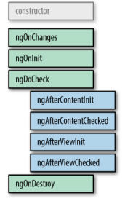
Lifecicle
Notes:
Components (and directives) in Angular have their own lifecycle, from creation, ren‐
dering, changing, to destruction. This lifecycle executes in preorder tree traversal
order, from top to bottom. After Angular renders a component, it starts the lifecycle
for each of its children, and so on until the entire application is rendered.
There are times when these lifecycle events are useful to us in developing our applica‐
tion, so Angular provides hooks into this lifecycle so that we can observe and react as
necessary. Figure 4-1 shows the lifecycle hooks of a component, in the order in which
they are invoked.
Figure 4-1. Angular component lifecycle hooks (original from https://angular.io/guide/
lifecycle-hooks)
Angular will first call the constructor for any component, and then the various steps
mentioned earlier in order. Some of them, like the OnInit and AfterContentInit
(basically, any lifecycle hook ending with Init ) is called only once, when a compo‐
nent is initialized, while the others are called whenever any content changes. The
OnDestroy hook is also called only once for a component.
Component Lifecycle | 71
Each of these lifecycle steps comes with an interface that should be implemented
when a component cares about that particular lifecycle, and each interface provides a
function starting with ng that needs to be implemented. For example, the OnInit life‐
cycle step needs a function called ngOnInit to be implemented in the component and
so on.
We will walk through each of the lifecycle steps here, and then use one example to see
this all in action and the ordering of lifecycle steps within a component and across
components.
There is also one more concept to learn, which we will briefly touch upon in this
chapter, and come back to later in more detail—the concept of ViewChildren and
ContentChildren .
ViewChildren is any child component whose tags/selectors (mostly elements, as that
is the recommendation for components) appear within the template of the compo‐
nent. So in our case, app-stock-item would be a ViewChild of the AppComponent .
ContentChildren is any child component that gets projected into the view of the
component, but is not directly included in the template within the component. Imag‐
ine something like a carousel, where the functionality is encapsulated in the compo‐
nent, but the view, which could be images or pages of a book, comes from the user of
the component. Those are generally achieved through ContentChildren . We will
cover this in more depth later in this chapter.
Interfaces and Functions
Table 4-1 shows the interfaces and functions in the order in which they are called,
along with specific details about the step if there is anything to note. Note that we are
only covering component-specific lifecycle steps, and they are slightly different from
a directive’s lifecycle.
Table 4-1. Angular lifecycle hooks and methods
Interface Method Applicable to Purpose
OnChanges ngOn
Changes(changes:
SimpleChange)
Components
and directives
ngOnChanges is called both right after the constructor to
set and then later every time the input properties to a directive
change. It is called before the ngOnInit method.
OnInit ngOnInit() Components
and directives
This is your typical initialization hook, allowing you to do any
one-time initialization specific to your component or directive.
This is the ideal place to load data from the server and so on,
rather than the constructor, both for separation of concerns as
well as testability.
72 | Chapter 4: Understanding and Using Angular Components
Interface Method Applicable to Purpose
DoCheck ngDoCheck() Components
and directives
DoCheck is Angular’s way of giving the component a way to
check if there are any bindings or changes that Angular can’t
or should not detect on its own. This is one of the ways we can
use to notify Angular of a change in the component, when we
override the default ChangeDetectionStrategy for a
component from Default to OnPush .
After
Content
Init
ngAfterContent
Init()
Components
only
As mentioned, the AfterContentInit hook is triggered
during component projection cases, and only once during
initialization of the component. If there is no projection, this is
triggered immediately.
After
Content
Checked
ngAfterContent
Checked()
Components
only
AfterContentChecked is triggered each time Angular’s
change detection cycle executes, and in case it is initialization,
it is triggered right after the AfterContentInit hook.
AfterView
Init
ngAfterViewInit() Components
only
AfterViewInit is the complement to AfterContent
Init , and is triggered after all the child components that are
directly used in the template of the component are finished
initializing and their views updated with bindings. This may
not necessarily mean that the views are rendered into the
browser, but that Angular has finished updating its internal
views to render as soon as possible. AfterViewInit is
triggered only once during the load of the component.
AfterView
Checked
ngAfterView
Checked()
Components
only
AfterViewChecked is triggered each time after all the
child components have been checked and updated. Again, a
good way to think about both this and AfterContent
Checked is like a depth-first tree traversal, in that it will
execute only after all the children components’ AfterView
Checked hooks have finished executing.
OnDestroy ngOnDestroy() Components
and directives
The OnDestroy hook is called when a component is about
to be destroyed and removed from the UI. It is a good place to
do all cleanup, like unsubscribing any listeners you may have
initialized and the like. It is generally good practice to clean up
anything that you have registered (timers, observables, etc.) as
part of the component.
Let’s try to add all these hooks to our existing application to see the order of execution
in a real-world scenario. We will add all of these hooks to both our AppComponent and
the StockItemComponent , with a simple console.log to just see when and how these
functions are executed. We will use the base from the output example to build from,
so in case you are not coding along, you can take the example from chapter4/
component-output to build from there.
The final finished example is also available in chapter4/component-lifecycle.
First, we can modify the src/app/app.component.ts file and add the hooks as follows:
import { Component, SimpleChanges, OnInit, OnChanges, OnDestroy,
DoCheck, AfterViewChecked, AfterViewInit, AfterContentChecked,
AfterContentInit } from '@angular/core';
Component Lifecycle | 73
import { Stock } from 'app/model/stock';
@Component({
selector: 'app-root',
templateUrl: './app.component.html',
styleUrls: ['./app.component.css']
})
export class AppComponent implements OnInit, OnChanges, OnDestroy,
DoCheck, AfterContentChecked,
AfterContentInit, AfterViewChecked,
AfterViewInit {
title = 'app works!';
public stock: Stock;
onToggleFavorite(stock: Stock) {
console.log('Favorite for stock ', stock, ' was triggered');
this.stock.favorite = !this.stock.favorite;
}
ngOnInit(): void {
this.stock = new Stock('Test Stock Company', 'TSC', 85, 80);
console.log('App Component - On Init');
}
ngAfterViewInit(): void {
console.log('App Component - After View Init');
}
ngAfterViewChecked(): void {
console.log('App Component - After View Checked');
}
ngAfterContentInit(): void {
console.log('App Component - After Content Init');
}
ngAfterContentChecked(): void {
console.log('App Component - After Content Checked');
}
ngDoCheck(): void {
console.log('App Component - Do Check');
}
ngOnDestroy(): void {
console.log('App Component - On Destroy');
}
ngOnChanges(changes: SimpleChanges): void {
console.log('App Component - On Changes - ', changes);
}
}
You can see that we have implemented the interfaces for OnInit, OnChanges,
OnDestroy, DoCheck, AfterContentChecked, AfterContentInit, AfterView
Checked, AfterViewInit on the AppComponent class, and then went ahead and
74 | Chapter 4: Understanding and Using Angular Components
implemented the respective functions. Each of the methods simply prints out a log
statement mentioning the component name and the trigger method name.
Similarly, we can do the same for the StockItemComponent :
import { Component, SimpleChanges, OnInit,
OnChanges, OnDestroy, DoCheck, AfterViewChecked,
AfterViewInit, AfterContentChecked,
AfterContentInit, Input,
Output, EventEmitter } from '@angular/core';
import { Stock } from '../../model/stock';
@Component({
selector: 'app-stock-item',
templateUrl: './stock-item.component.html',
styleUrls: ['./stock-item.component.css']
})
export class StockItemComponent implements OnInit, OnChanges,
OnDestroy, DoCheck,
AfterContentChecked,
AfterContentInit,
AfterViewChecked,
AfterViewInit {
@Input() public stock: Stock;
@Output() private toggleFavorite: EventEmitter<Stock>;
constructor() {
this.toggleFavorite = new EventEmitter<Stock>();
}
onToggleFavorite(event) {
this.toggleFavorite.emit(this.stock);
}
ngOnInit(): void {
console.log('Stock Item Component - On Init');
}
ngAfterViewInit(): void {
console.log('Stock Item Component - After View Init');
}
ngAfterViewChecked(): void {
console.log('Stock Item Component - After View Checked');
}
ngAfterContentInit(): void {
console.log('Stock Item Component - After Content Init');
}
ngAfterContentChecked(): void {
console.log('Stock Item Component - After Content Checked');
}
ngDoCheck(): void {
console.log('Stock Item Component - Do Check');
Component Lifecycle | 75
}
ngOnDestroy(): void {
console.log('Stock Item Component - On Destroy');
}
ngOnChanges(changes: SimpleChanges): void {
console.log('Stock Item Component - On Changes - ', changes);
}
}
We have done exactly the same thing we did on the AppComponent with the Stock
ItemComponent . Now, we can run this application to see it in action.
When you run it, open the JavaScript console in the browser. You should see, in order
of execution:
1. First, the AppComponent gets created. Then the following hooks are triggered on
the AppComponent :
• On Init
• Do Check
• After Content Init
• After Content Checked
The preceding two immediately execute because we don’t have any content pro‐
jection in our application so far.
2. Next, the StockItemComponent OnChanges executes, with the input to the Stock
ItemComponent being recognized as the change, followed by the hooks listed here
within the StockItemComponent :
• On Init
• Do Check
• After Content Init
• After Content Checked
• After View Init
• After View Checked
3. Finally, there are no more subcomponents to traverse down on, so Angular steps
back out to the parent AppComponent , and executes the following:
• After View Init
• After View Checked
76 | Chapter 4: Understanding and Using Angular Components
This gives us a nice view of how and in which order Angular goes around initializing
and the tree traversal it does under the covers. These hooks become very useful for
certain trickier initialization logic, and are definitely essential for cleanup once your
component is done and dusted, to avoid memory leaks.

Slide 30
EJERCICIO!

Slide 31
EJERCICIO
Crea un componente tipo el de stocks llamado ProductListComponent e inicia un listado de productos/stocks o como quieras llamarlos. Crea un ProductItemComponent para mostrar los datos del item. Haz un ngFor en el list para mostrar n veces el item
Usa estilos con ngClass o ngStyle.
Cambia el ProductItemComponent para tomar el item como input.
Coloca botones para subir o bajar la cantidad de items desde el list.
Crea botones para cambiar el precio del ítem pero la lógica de cambiarlo que este en el list, (output desde el hijo). Usa el index para ayudarte a identificar el producto (o directamente pásale el producto por el emitter).
Haz optimo el componente de ProductItemComponent cambiándole la estrategia a OnPush

Slide 32


AHORA A POR LA PARTE 3
Y otro descansito

